Slide 1
Impact of Litter flushed down the WC
v
v

Slide 2
Litter
As you already know, litter (basuraleza) is all the garbage left in nature.
Garbage can reach it in several ways: when we go to the mountains or the beach and leave it there, when we travel and throw it out of the window or directly from home...
WATCHING THE VIDEO

Slide 3
Cotton swabs, wipes, dental floss, condoms, contact lenses, sanitary napkins, tampons... many products that bring convenience to our modern lives end up inappropriately in the toilet. The toilet is the gateway to nature for materials that are consumed quickly and frequently.
How does it get to nature from the toilet?

Slide 4
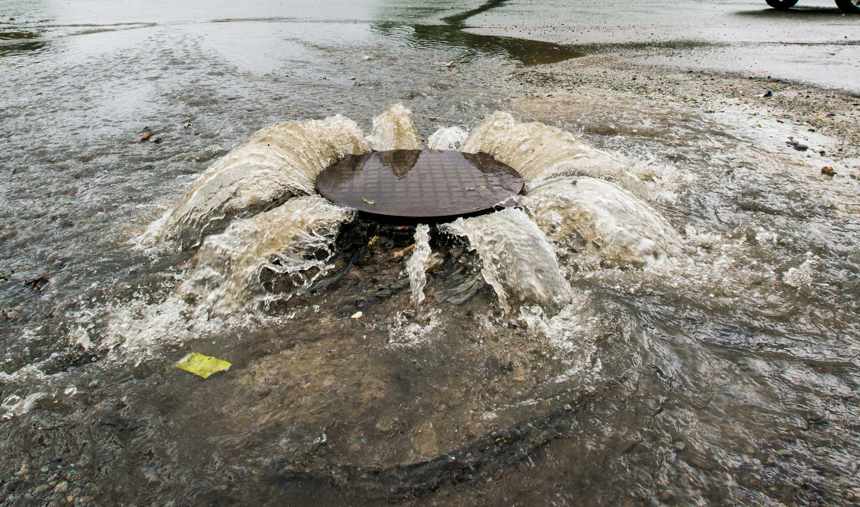
All these wastes cause clogging of city sewers and serious problems in rivers.

Slide 5
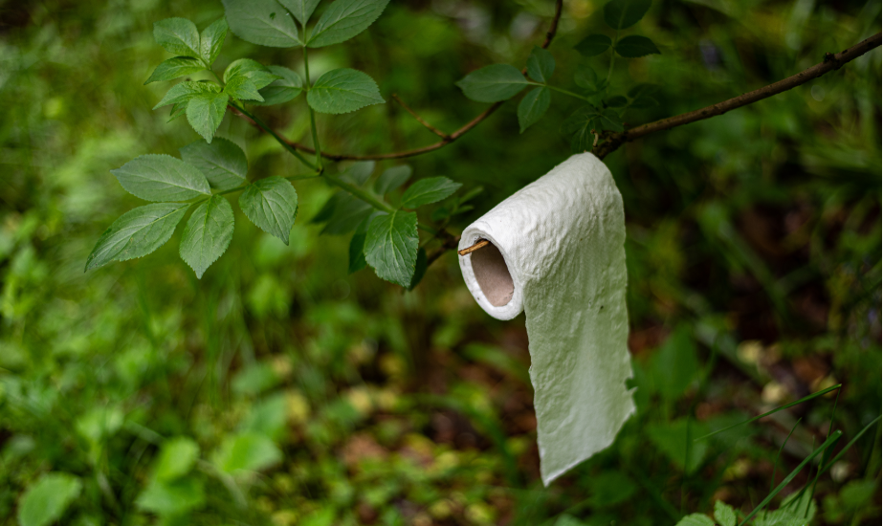
Although not all waste is flushed down the toilet, much of it is left directly in nature in remote and secluded places.

Slide 6
Does our behavior inside and outside the home have any impact on the environment?

Slide 7
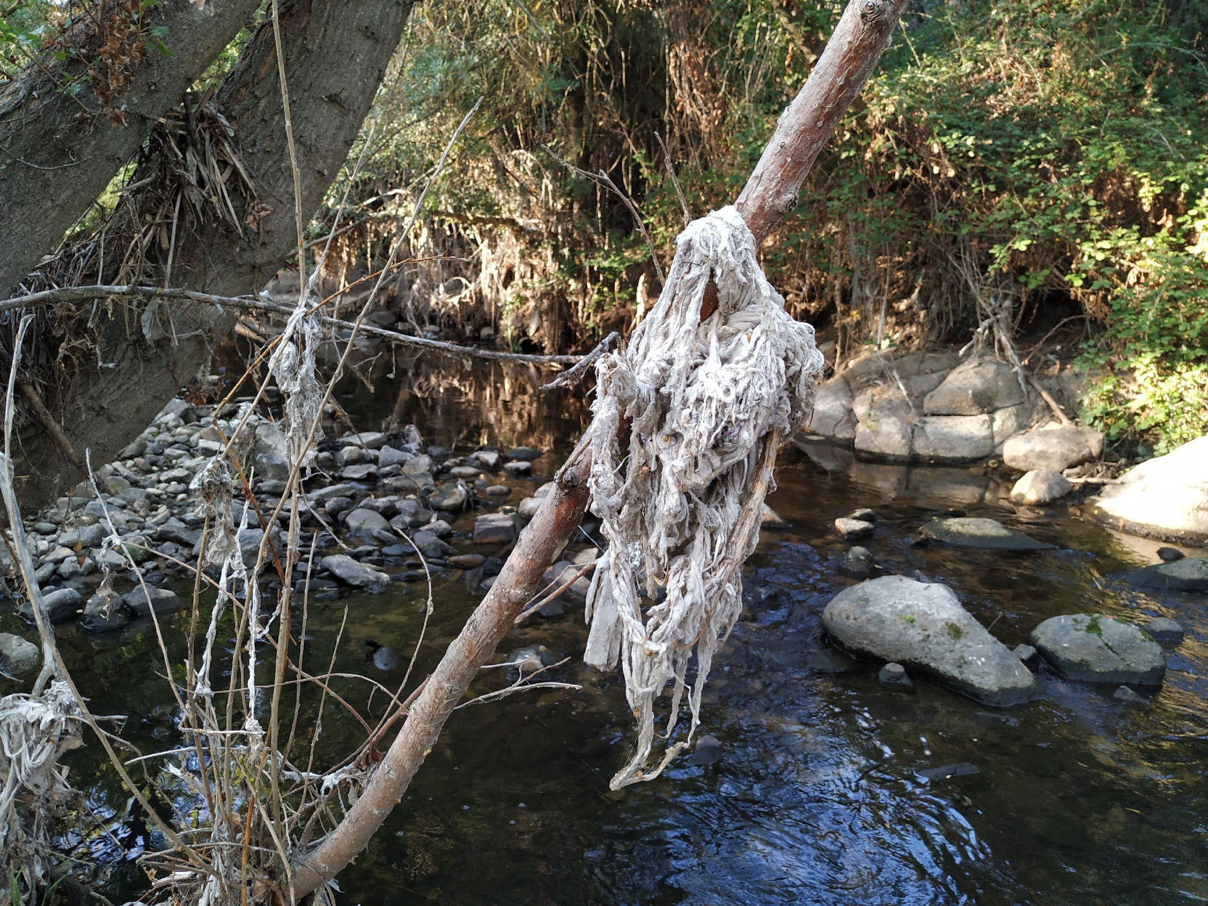
Wet wipes
Wipes break into small pieces, contributing to the microplastics problem. These small particles can enter the food chain and threaten marine life. Because of their weight, they tend to settle to the bottom of rivers and thus become a hidden threat, even changing river courses.

Slide 8
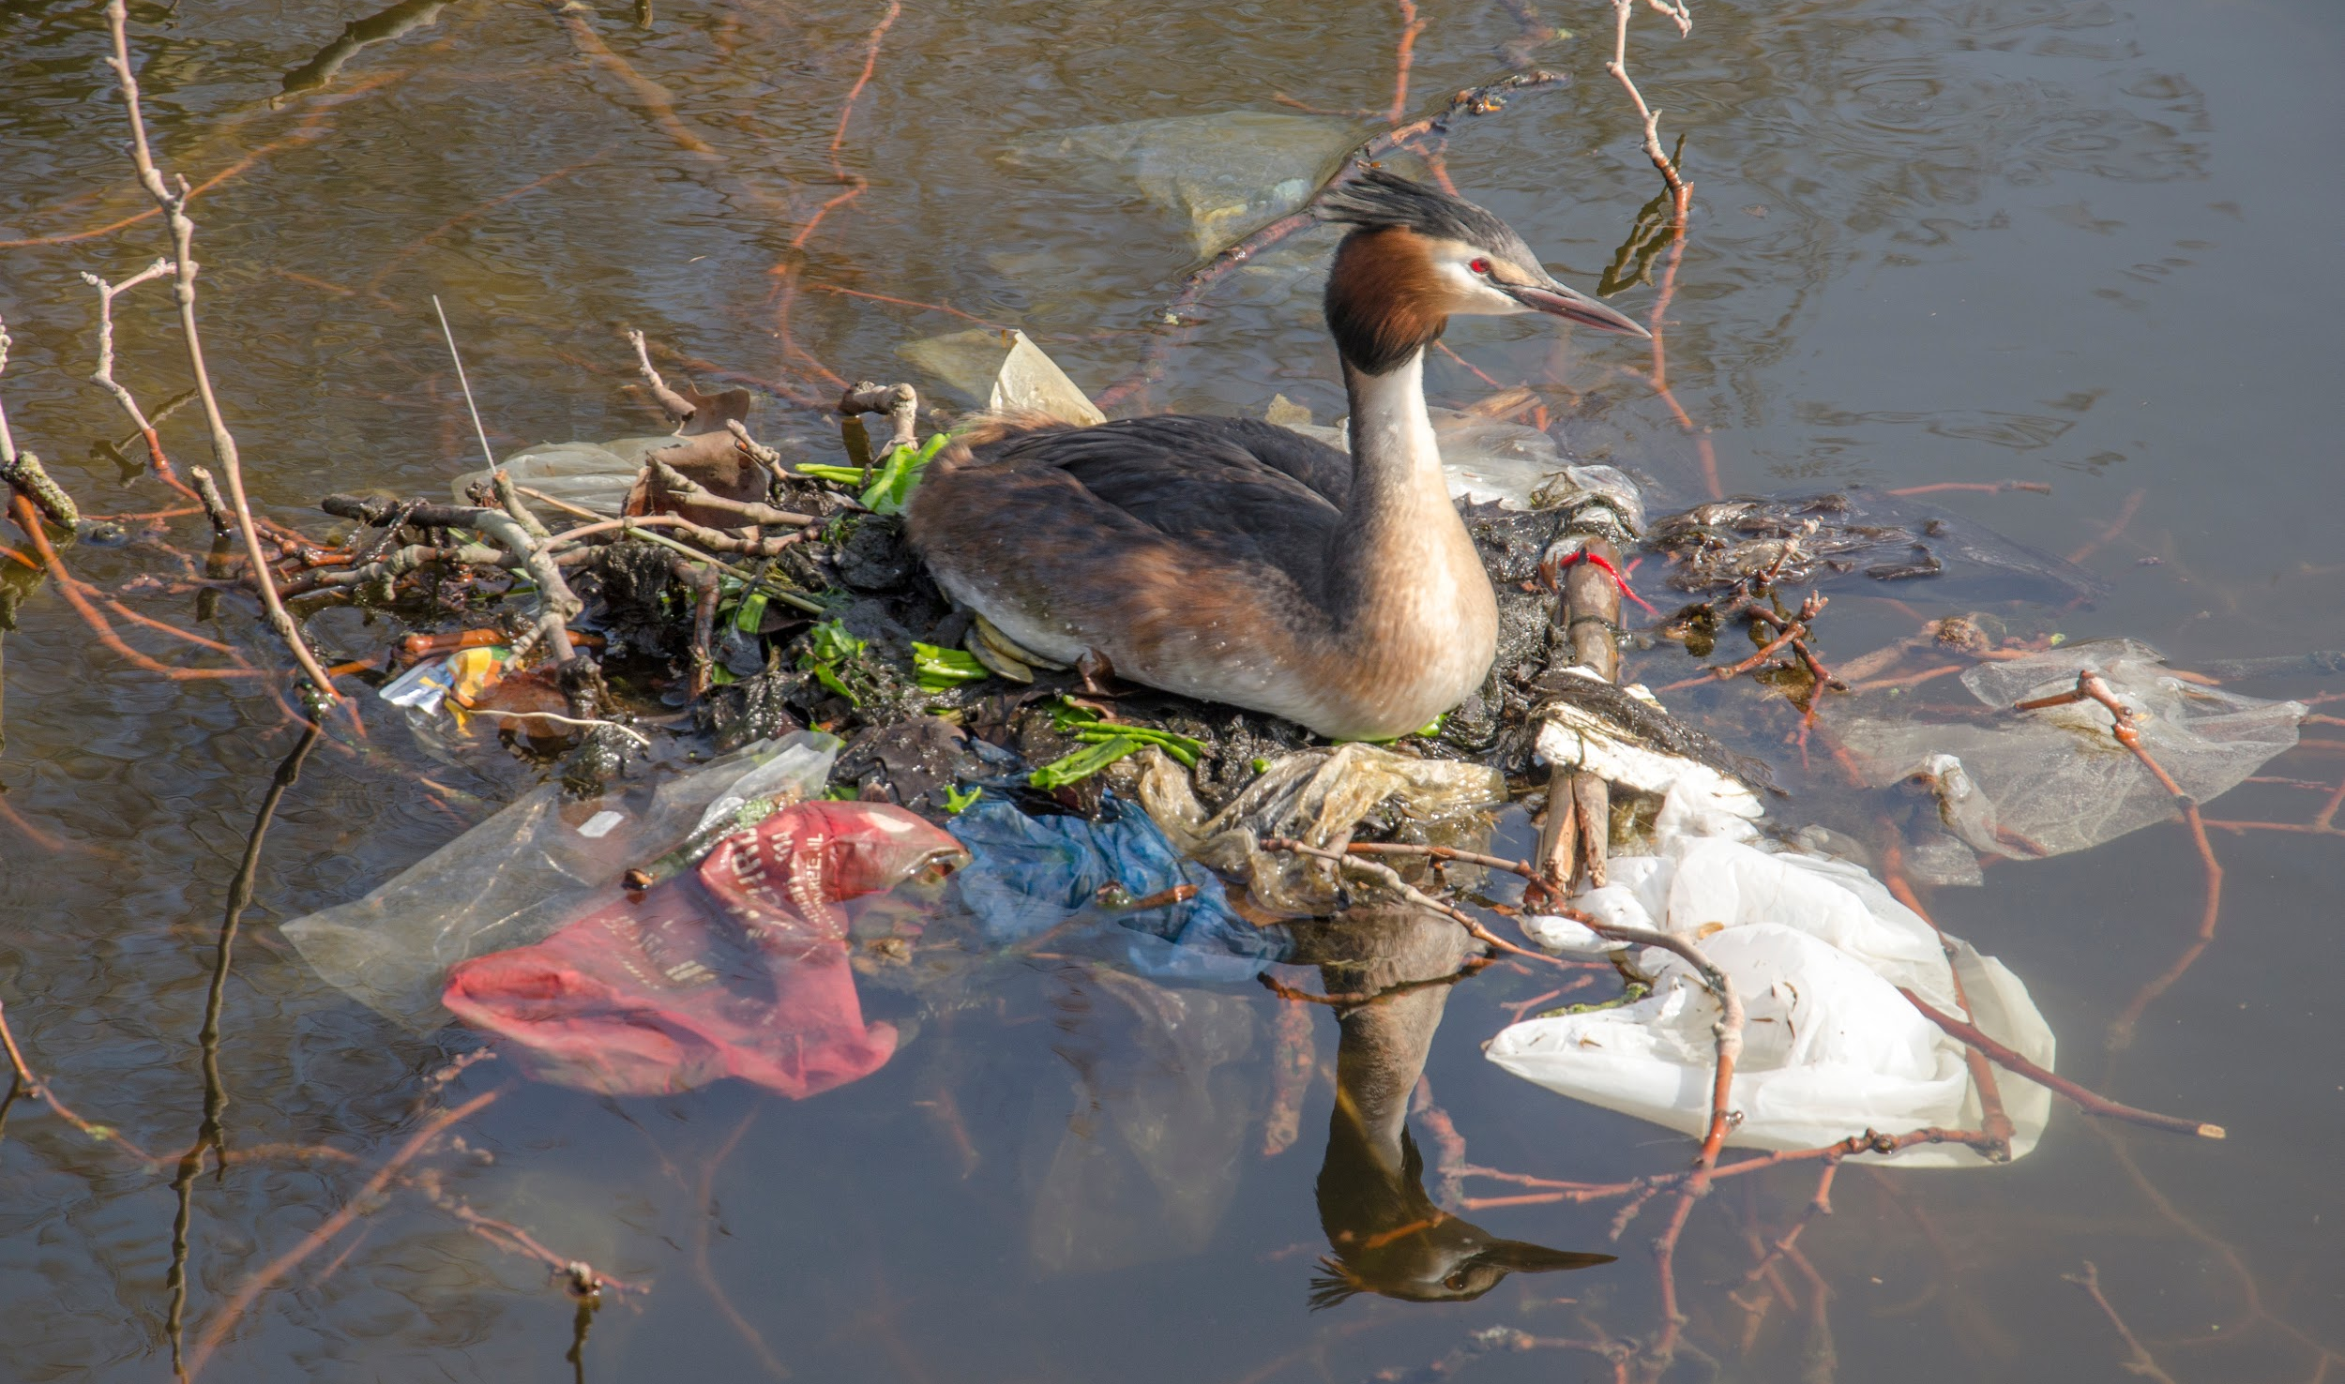
Plastics
The plastics discarded by the WC reach our rivers and reservoirs. In some places, they account for 8% of the waste found on beaches, affecting fauna, flora and ourselves. Many of the hygiene products we use most often contain plastic.

Slide 9
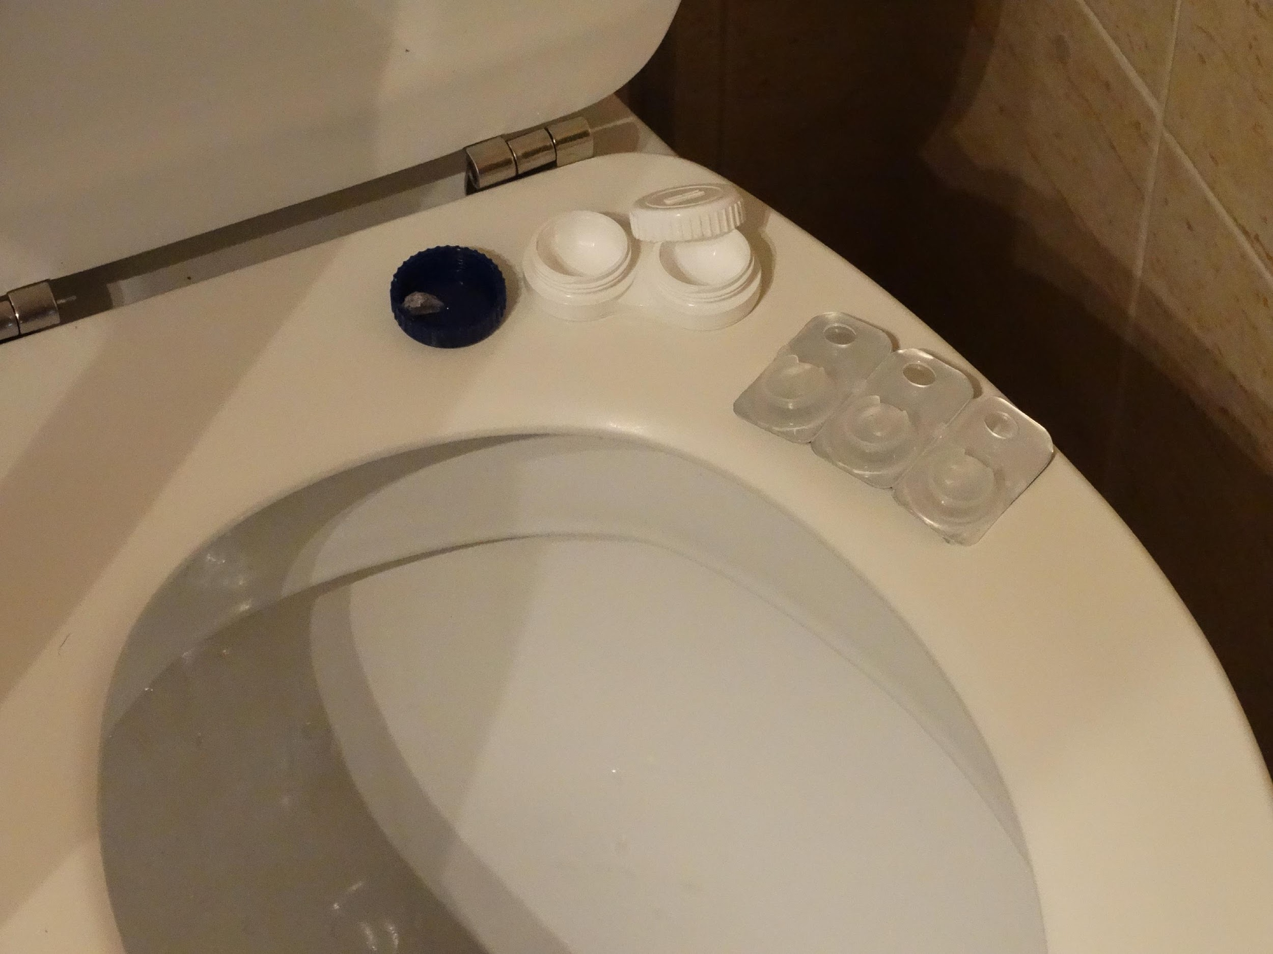
Contact lenses
Can what we flush down the washbasin also find its way into nature?
We often flush them down the toilet or sink and they can end up in nature. Contact lenses are made of very flexible plastic, which means they can pass through sewage treatment plant filters, fragment and lead to the formation of microplastics.

Slide 10
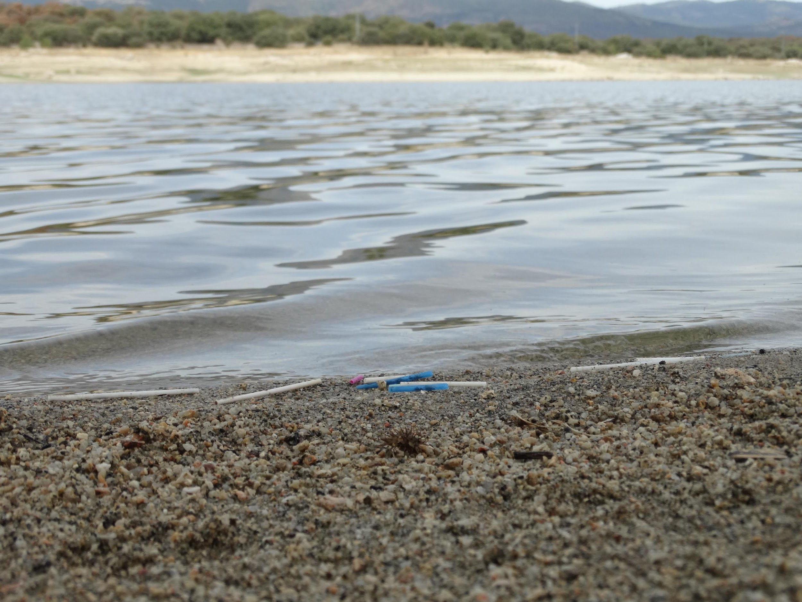
Ear sticks
Due to the fact that the stick is usually made of plastic, it is estimated that they need about 300 years to decompose. Their small size makes them easily pass through the filters of water treatment plants, ending up in our rivers and reservoirs, and causing damage to wildlife.

Slide 11
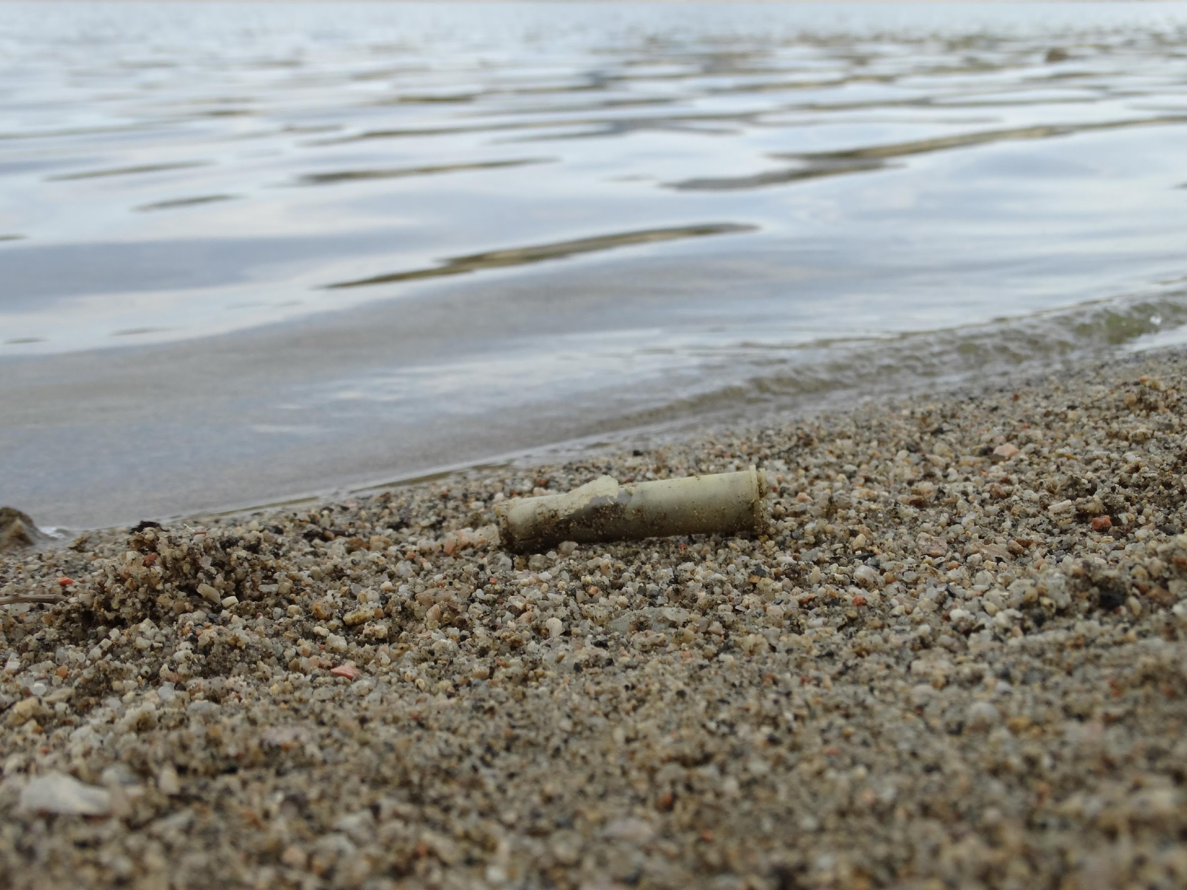
Feminine higiene products
They are the most commonly found in sewage systems. It is estimated that 70,000 panty liners, 2.5 million tampons and 1.4 million sanitary napkins are discarded every day in the United Kingdom. These are also dumped directly into natural terrestrial areas.

Slide 12
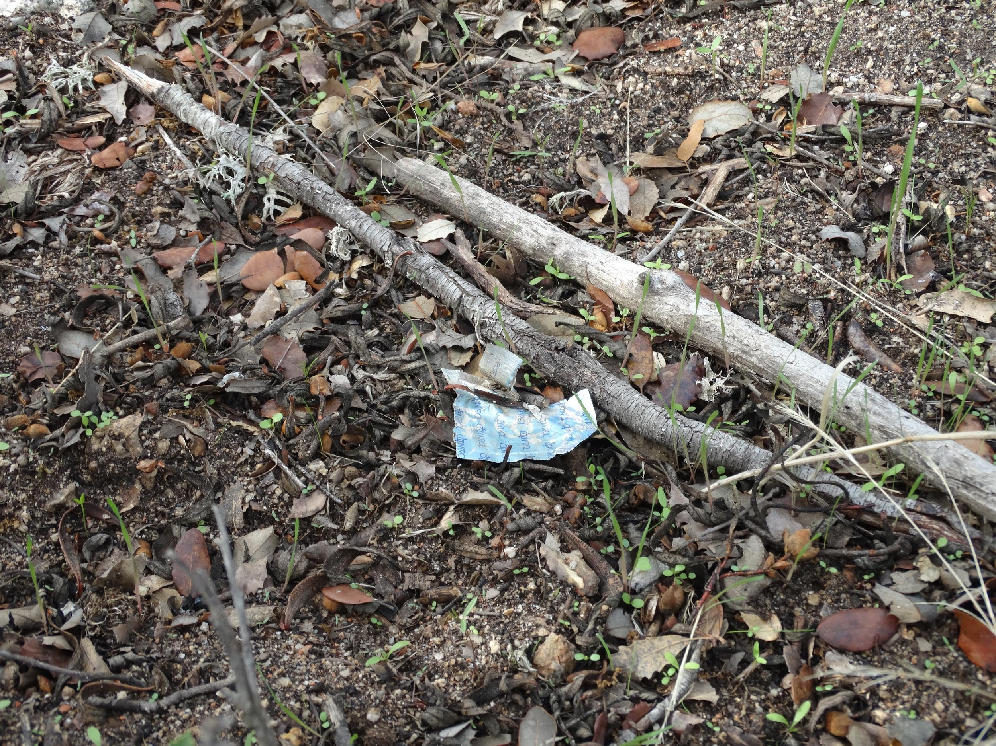
Condoms
They pose a threat to the environment, especially those containing polyurethane and nitrile rubber, although the most widely marketed are latex. They cause blockages in the drainage system, as well as environmental problems, and can contaminate ecosystems. They are also a danger to wildlife, which can ingest them by mistake. They can be a source of infections as they can carry bacteria and other contaminants.

Slide 13
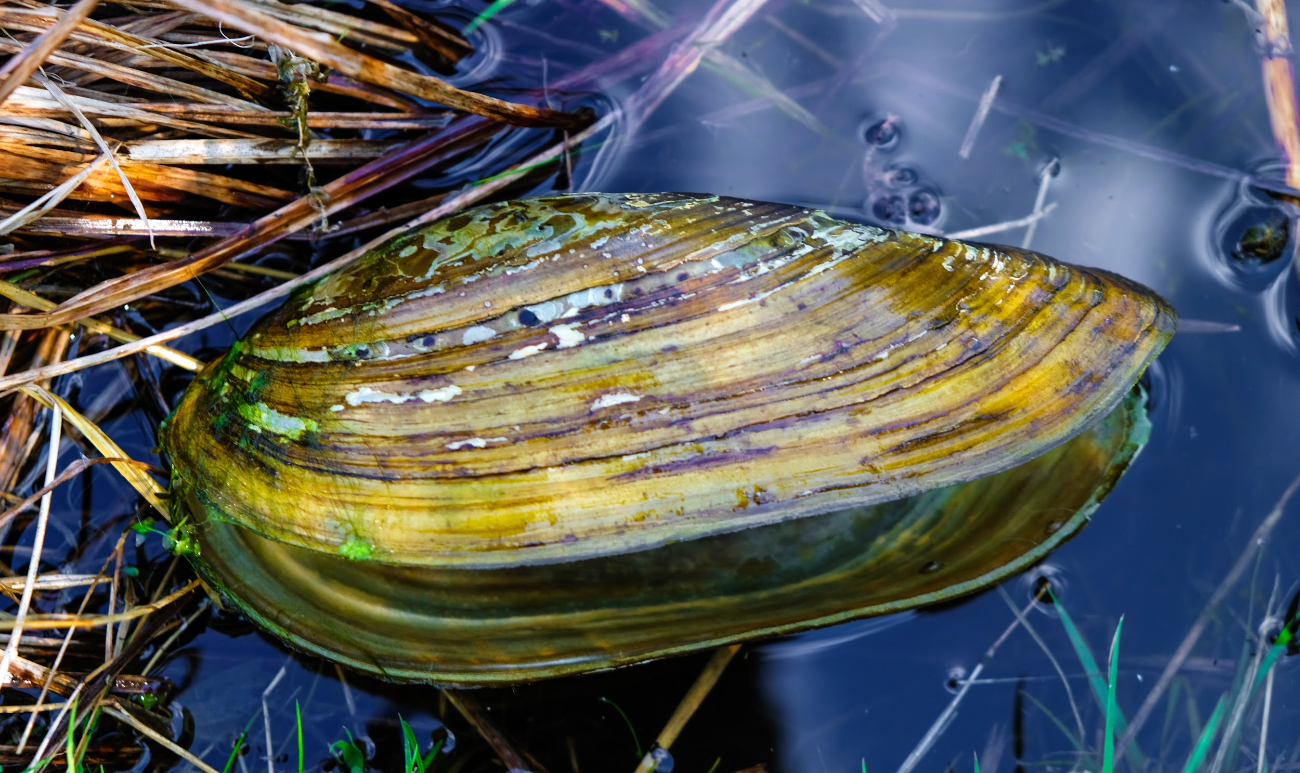
Medicines
They can cause behavioral changes in species, as in the case of the river mussel or the crayfish H. oregonensis that changed their behavior when exposed to fluoxetine (Prozac).

Slide 14
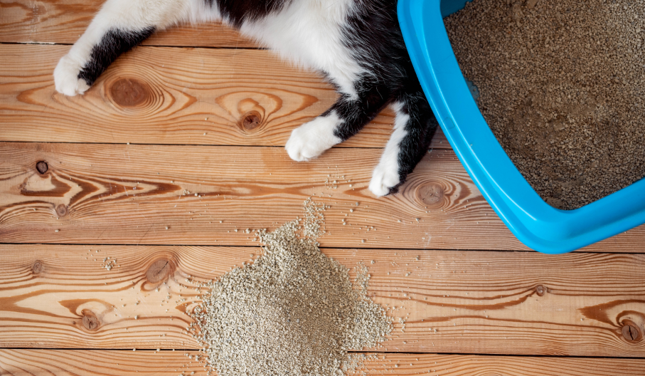
Cat litter
They are composed of clay, which hardens and can clog pipes, as well as their excrement, which quickly dehydrates and hardens.They can contain toxins and parasites such as Toxoplasma gondii that should not come into contact with our water system or natural spaces. Scientists have discovered that this parasite has contaminated coastal areas infecting marine mammals including sea otters.

Slide 15
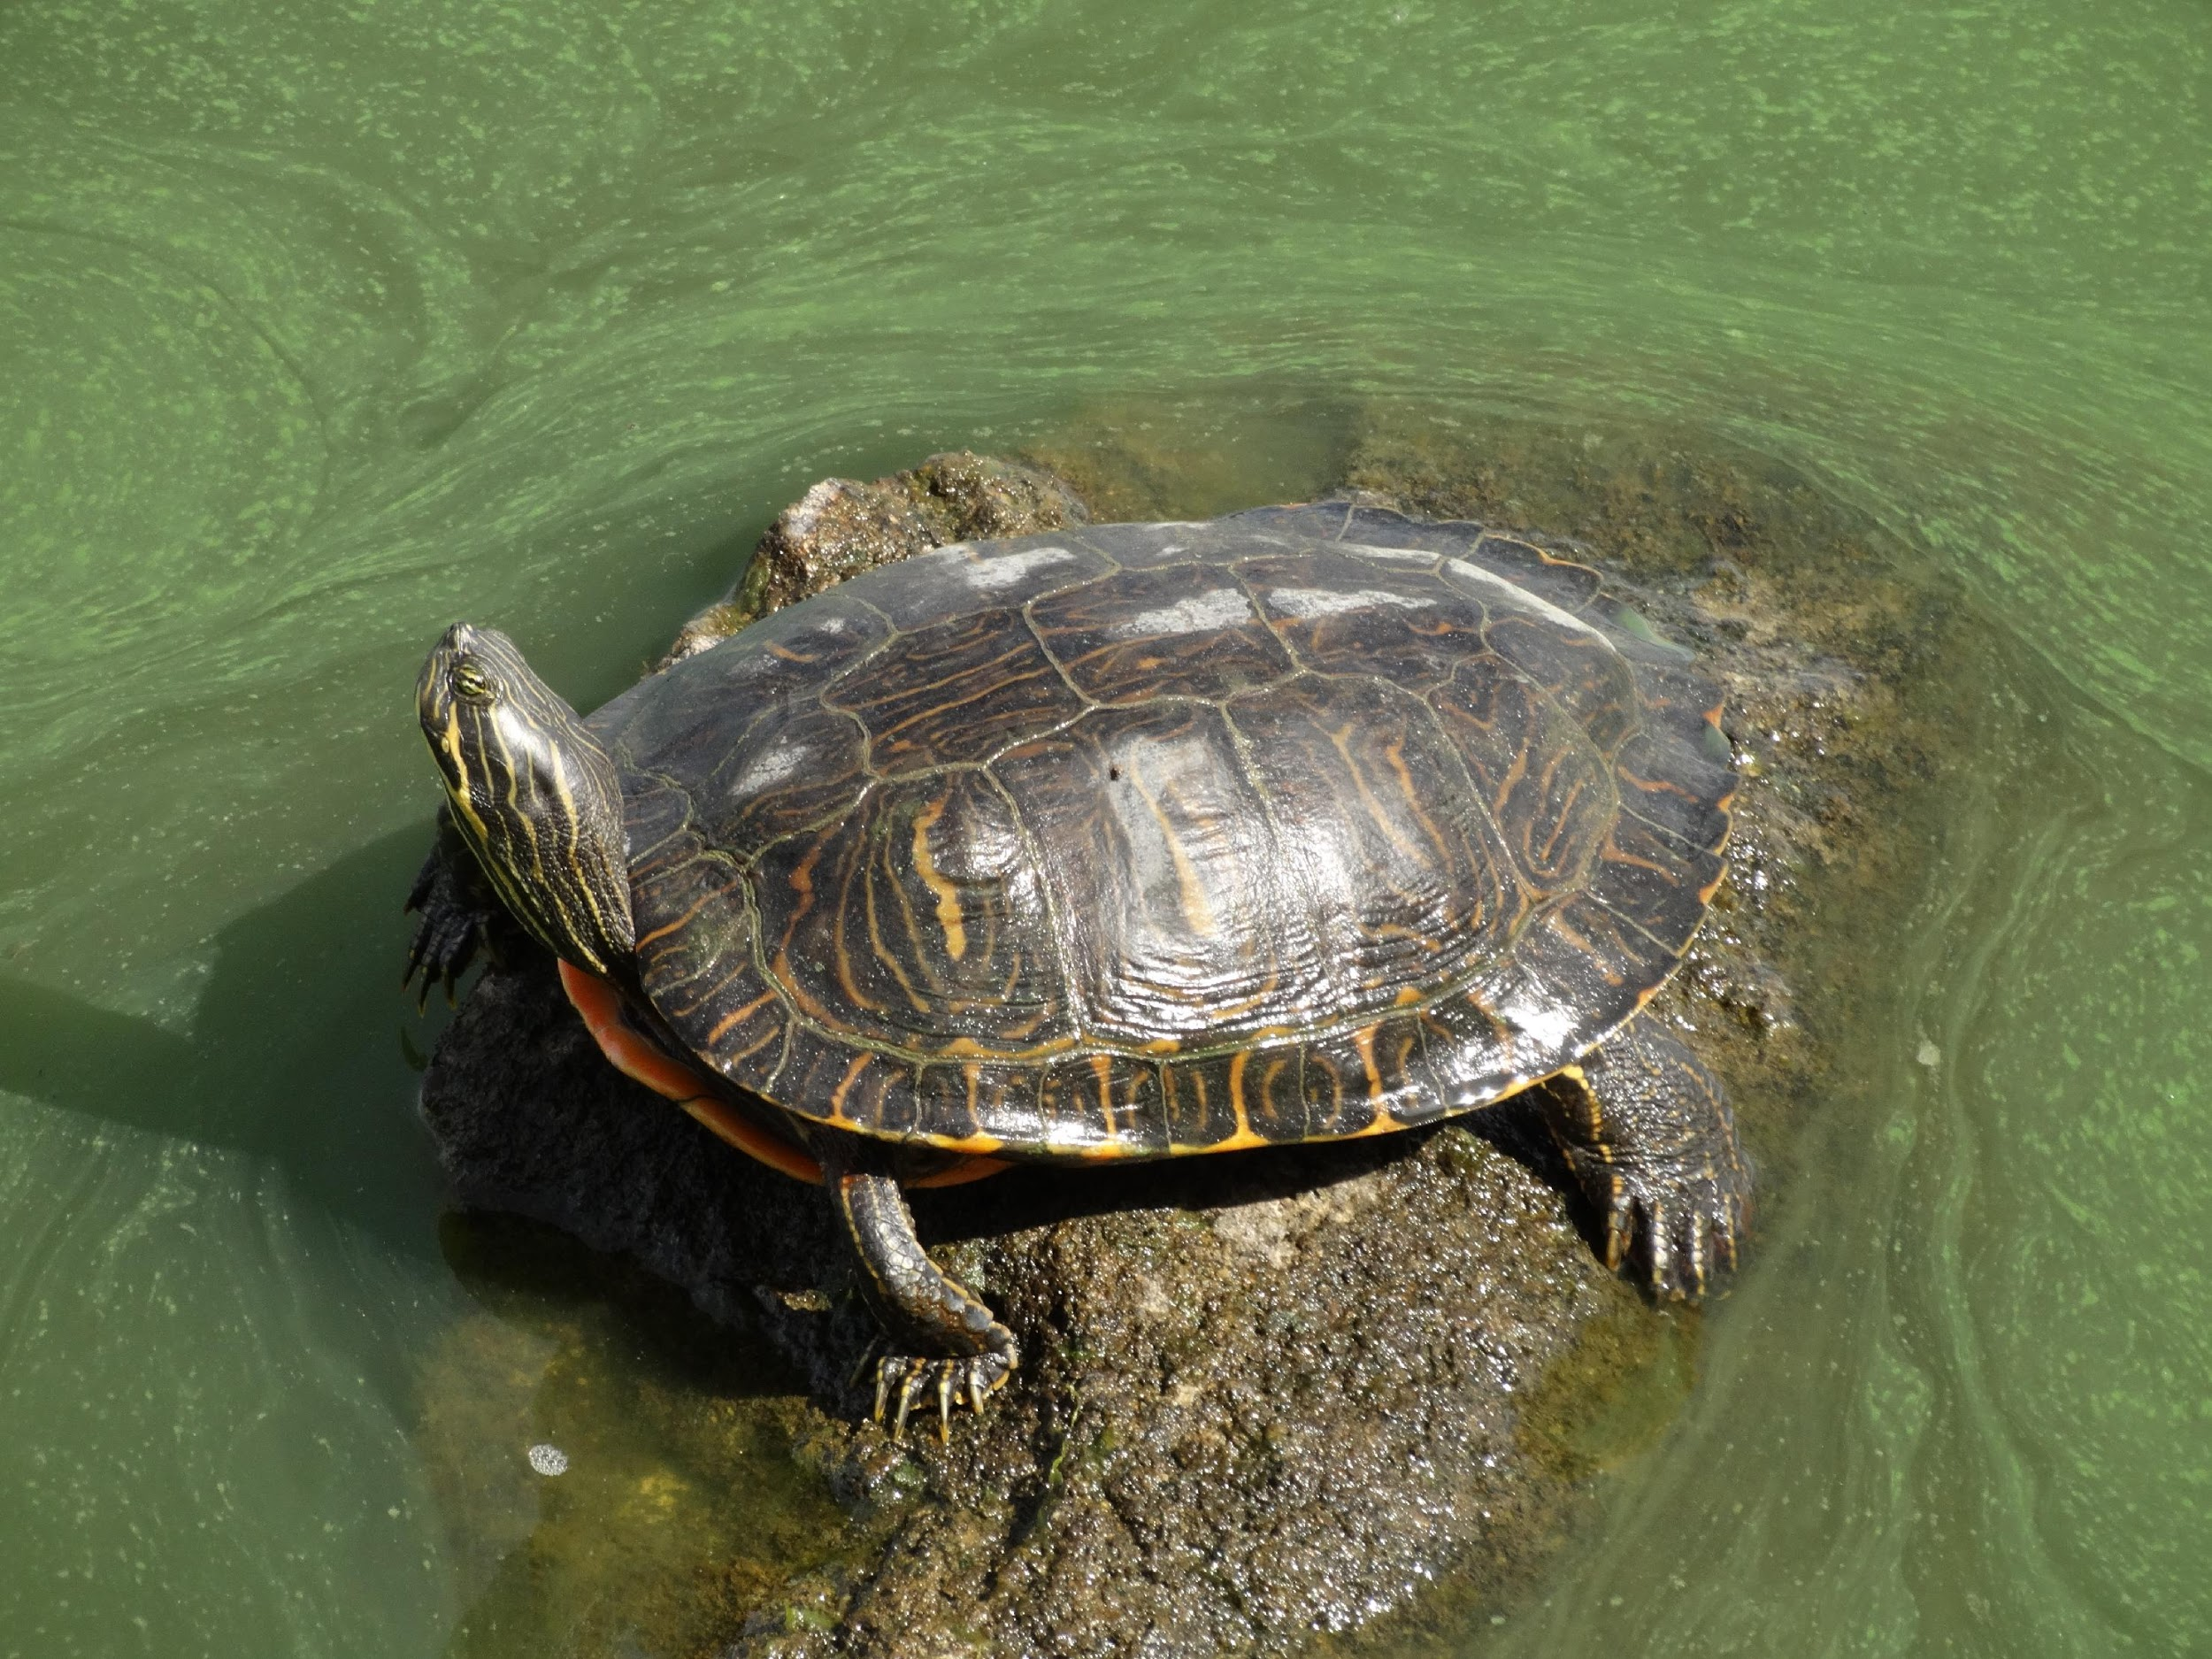
Small pets
This can contribute to the spread of parasites through the water, thus increasing the risk of infecting our local fauna. Not to mention that when exotic pets such as carp or freshwater turtles are released into the toilet, they can survive and end up in our rivers and lakes, and populations of these animals can become established in our ecosystems.

Slide 16
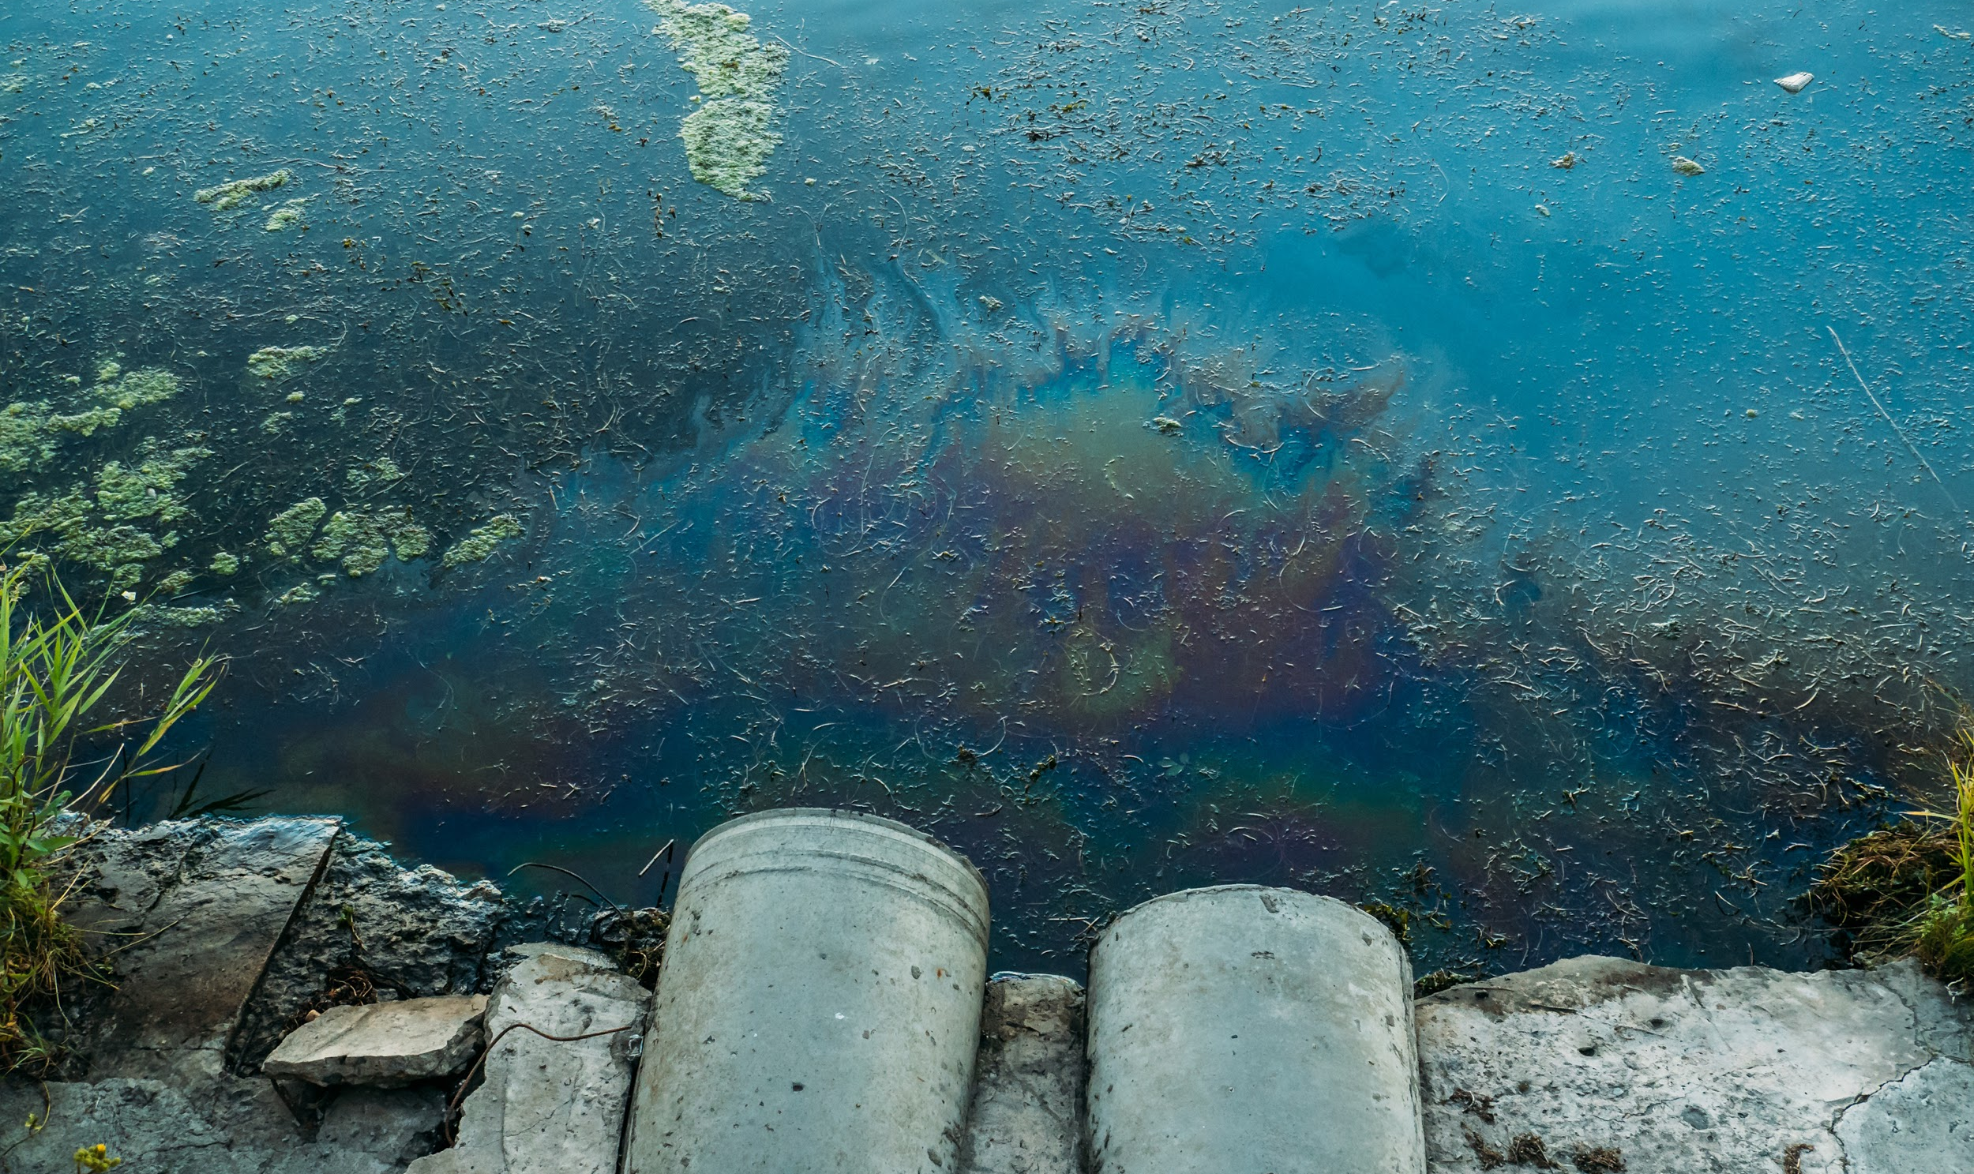
Chemicals
Cleaning chemicals such as bleach, ammonia or hydrochloric acid are also discharged into the toilet, oxidize organic matter and are capable of killing fauna and flora, as well as highly toxic products such as paints or solvents. Excessive discharge of soaps and detergents containing phosphates can lead to the growth of algae harmful to aquatic life.
Do the oils and foods we flush also have an impact?

Slide 17
Why do we flush waste down the toilet?
Can we use it as a waste garbage can?

Slide 18
Lack of knowledge
Some people justify it for hygienic reasons, others because they are small objects, for convenience or because they thought it was okay to do so. In addition, one out of two people believed that these objects disintegrate when flushed.

Slide 19
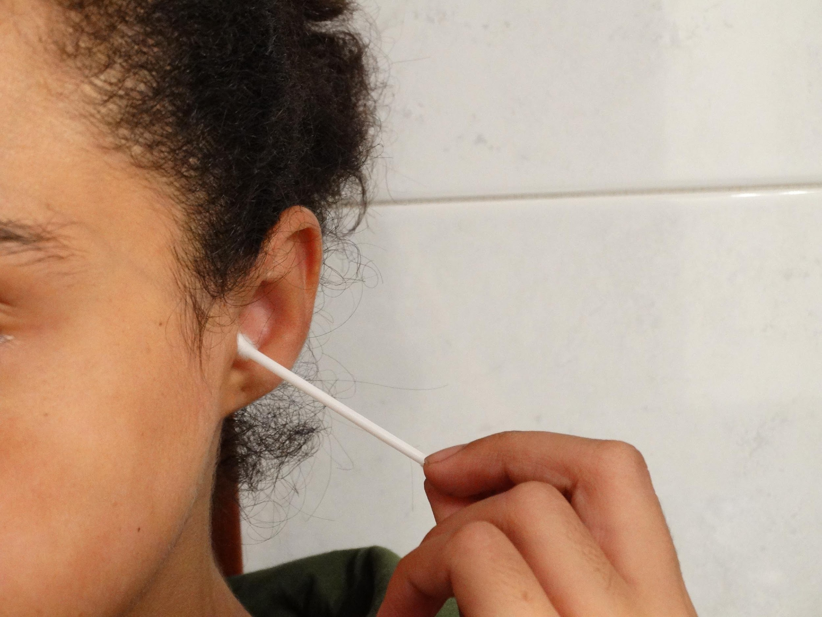
Lack of awareness and sensitization
We are often unaware of the damage that our actions can cause. By simply throwing a wipe or an ear swab down the toilet, we are causing damage, often irreversible damage to our ecosystems and even to ourselves.

Slide 20
Clear and reliable information
In order for consumers to have the necessary knowledge to properly manage waste, we need clear and reliable information. To this end, it is important that both consumer products and the institutions that look after citizens and consumers provide this information. Some products, such as wet wipes, are offered as biodegradable when they are not.

Slide 21
What can you do to solve the problem?

Slide 22
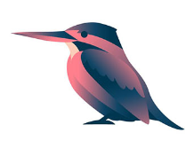
Be aware and do not flush anything other than your stool, urine and degradable toilet paper down the toilet.
Be responsible with the waste you generate when you are in natural environments.
Be aware of the environmental and health impact caused mainly by non-biodegradable solid waste.
Remember the 3P rule : pipi, popo and paper

Slide 23
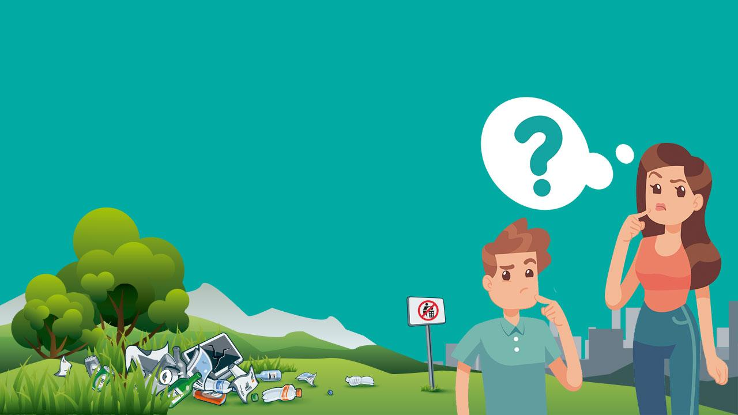
CONCLUSION

Slide 24
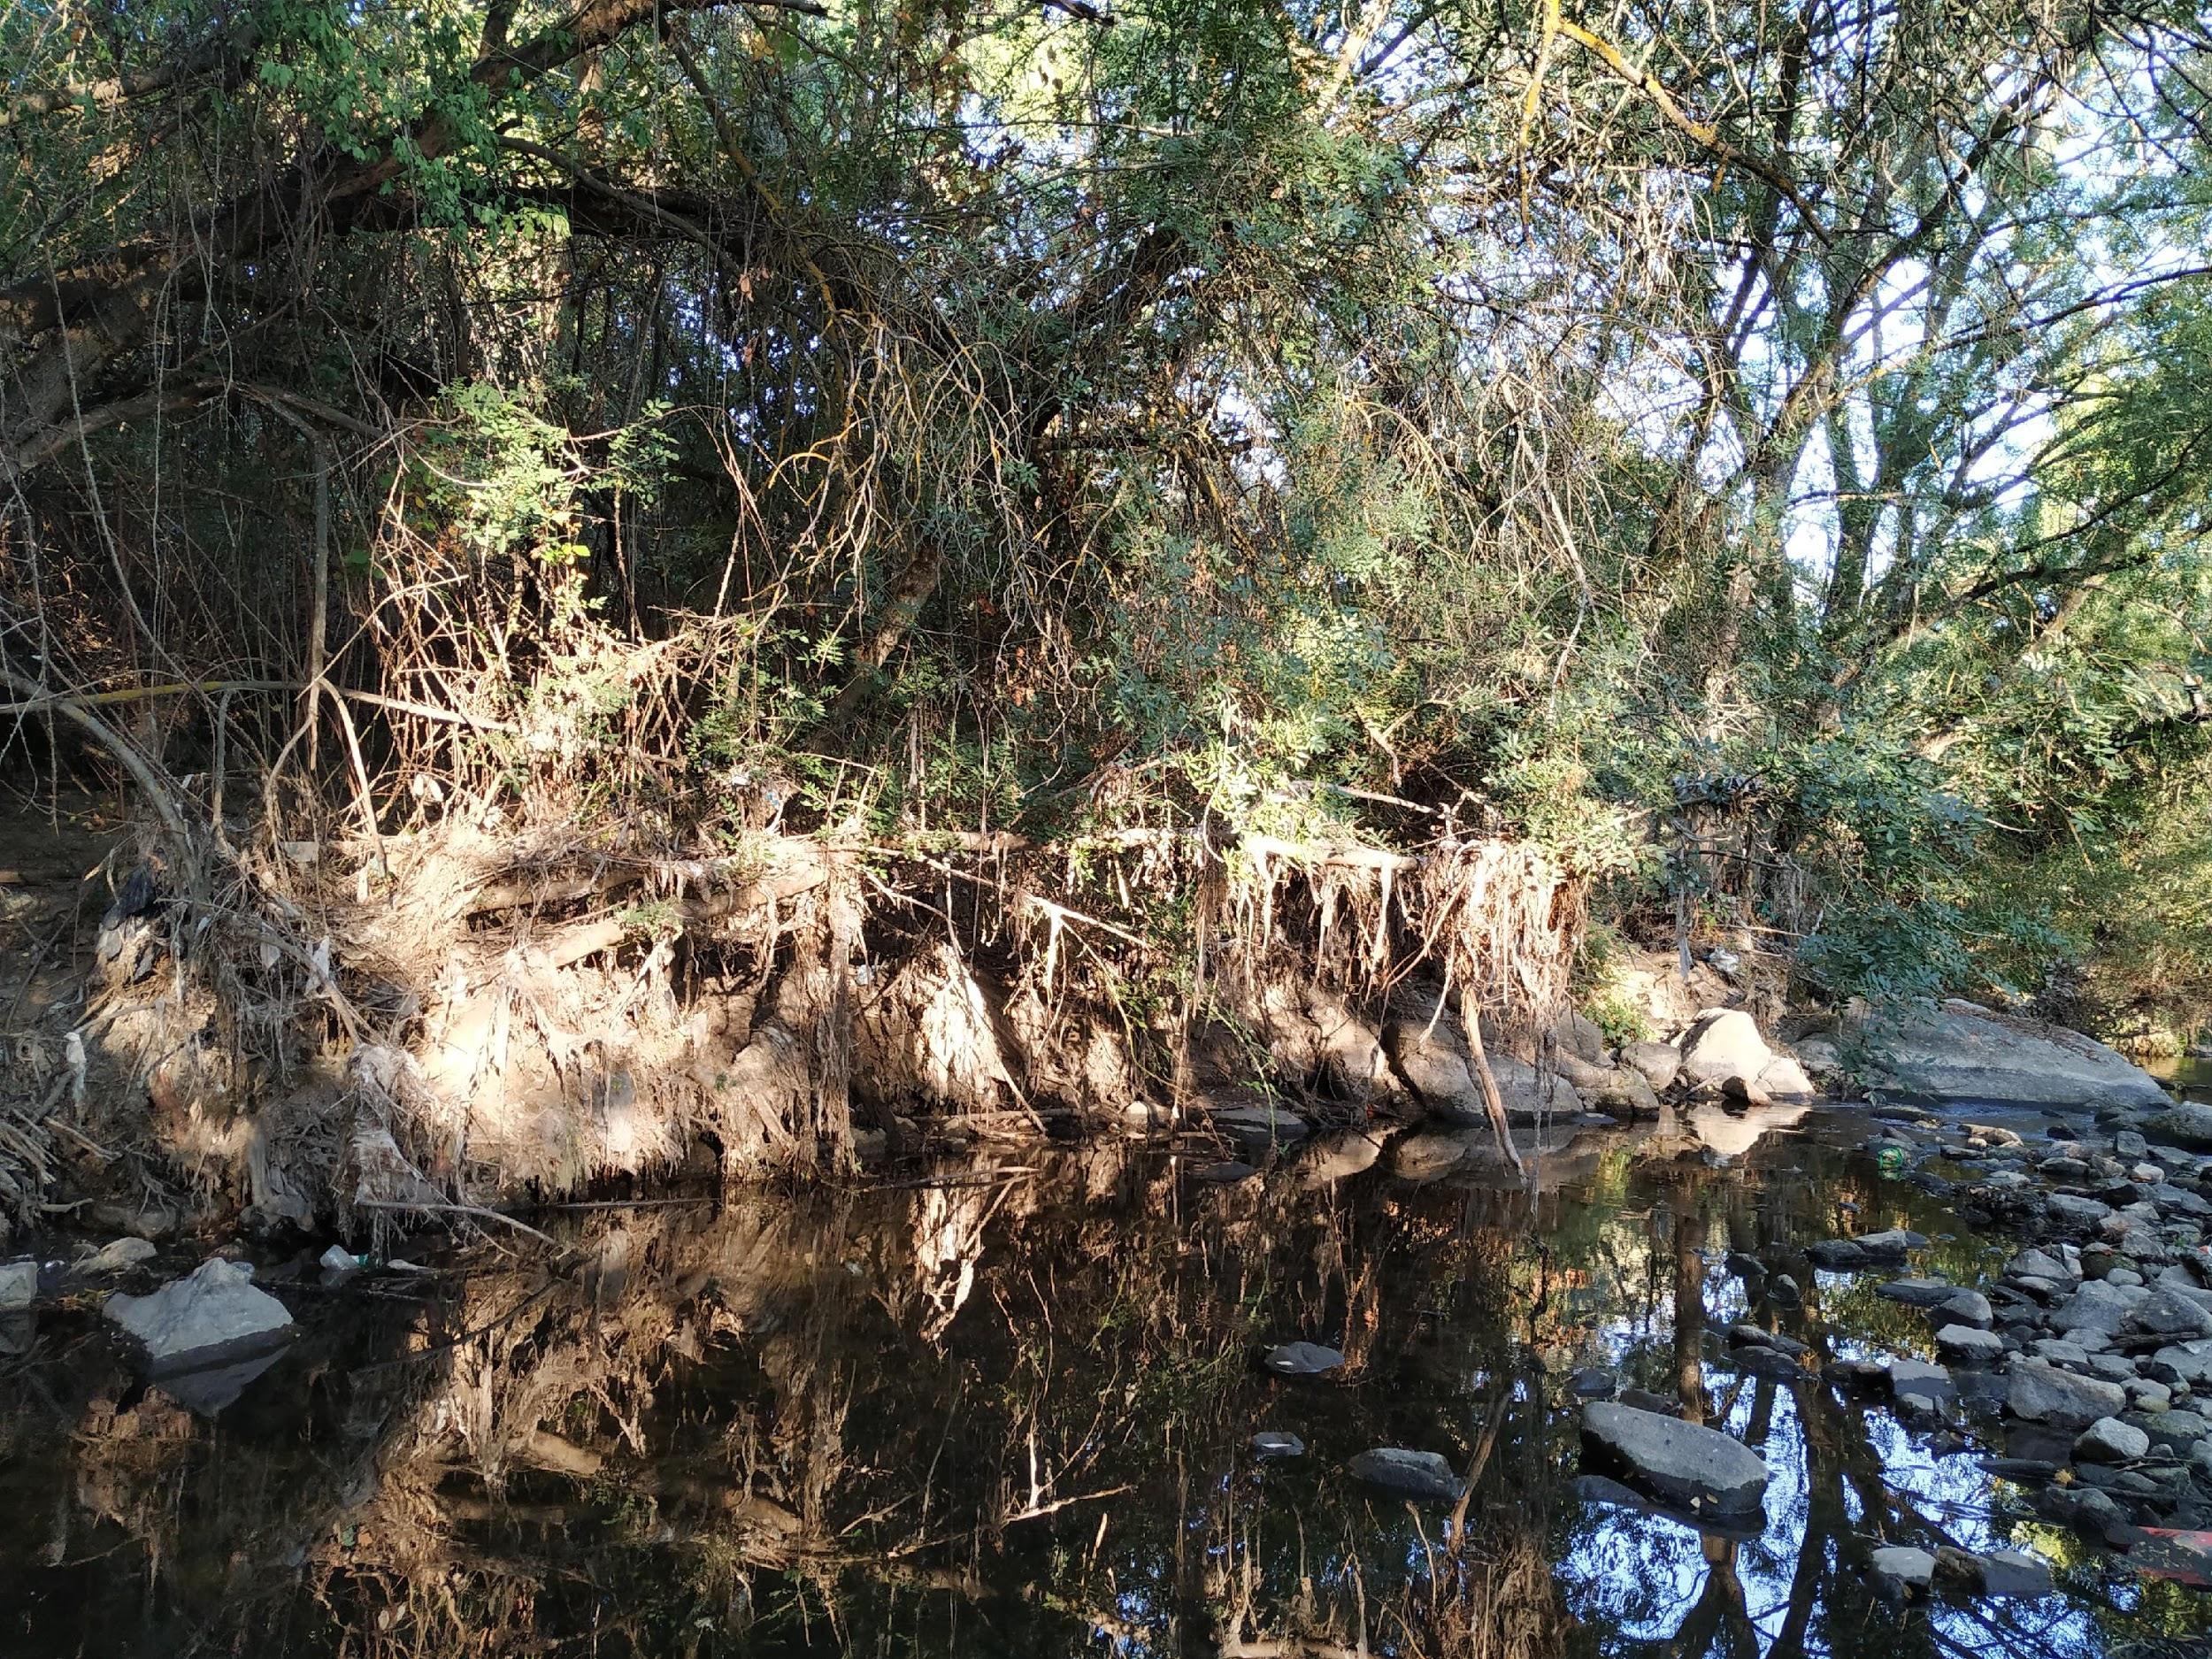
A simple everyday gesture such as flushing the toilet or walking in the countryside can have negative consequences for the environment, but it is up to us to know how to avoid it and apply it in our daily lives.

Slide 25
